Slide 1

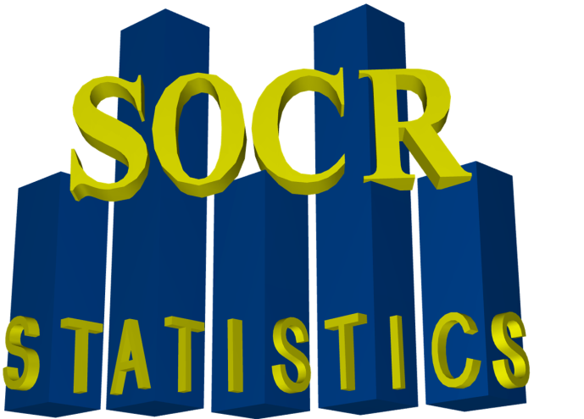
Technology-Enhanced Mathematics and Statistics Education
It’s Online, Therefore It Exists!
Ivo D. Dinov & Nicolas Christou
www.SOCR.ucla.edu

Slide 2

Outline
What is SOCR?
Webapps: Distributions, Experiments, Analyses, Games, Modeler, Graphs
Multilingual instructional resources: EBooks, Continuing Ed workshops
Learning activities: interactive, data-driven and technology-enhanced
Examples:
  Central Limit Theorem
  Hands-on California Ozone Data Activity
  Polynomial Model Fitting
  Stochastic estimation of transcendental numbers:
    Natural number e and π
  Hands-on Wavelet and Fourier representation and signal denoising
Data: Diverse publicly accessible datasets for copy-paste/download utilization – e.g., Latin Letters Frequency Distribution
Dissemination: papers, conferences, workshops, etc.

Slide 3
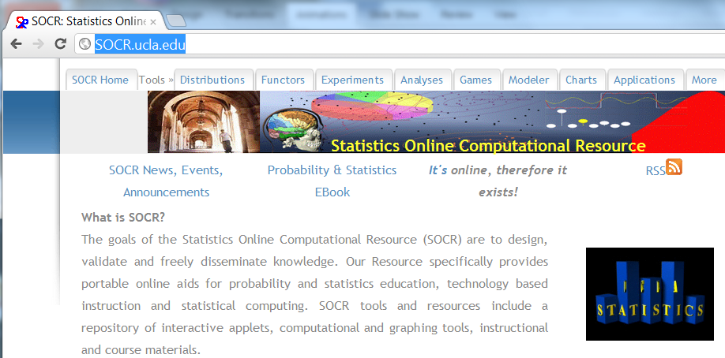
What is SOCR?

Slide 4





Core SOCR Resources
Data
http://wiki.stat.ucla.edu/socr/index.php/SOCR_Data
Concepts
& Methods
http://wiki.stat.ucla.edu/socr/index.php/EBook
Virtual Demos
http://www.SOCR.ucla.edu
Tools & Activities
http://www.SOCR.ucla.edu
wiki.stat.ucla.edu/socr/index.php/SOCR_EduMaterials
Infrastructure
http://socr.ucla.edu/SOCR_HT_ResourceViewer.html
http://wiki.stat.ucla.edu/socr/index.php/SOCR_News
http://socr.ucla.edu/htmls/SOCR_Languages.html
http://socr.ucla.edu/docs/SOCR_Documentation.html
Notes:
LONI Pipeline
One workflow environment for all components
Used to graphically describe workflows
Exploits parallelism in workflows
Uses available clustering technology & resources
Current Usage
Neuroimaging analysis, fMR, DTI, et al.

Slide 5

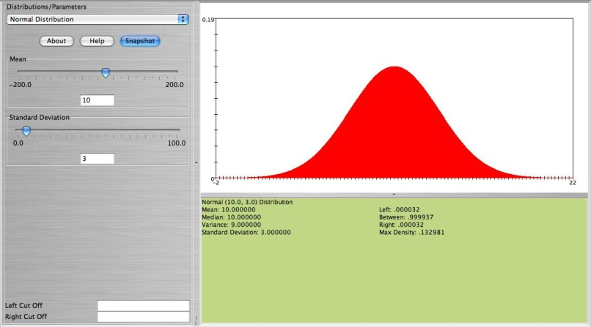
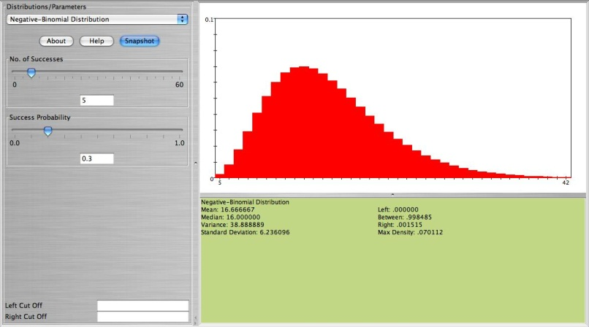
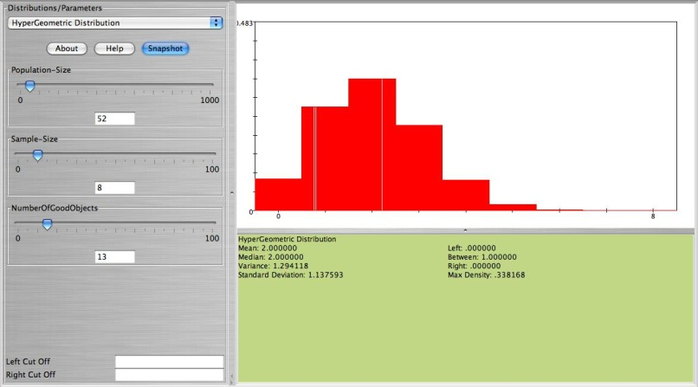
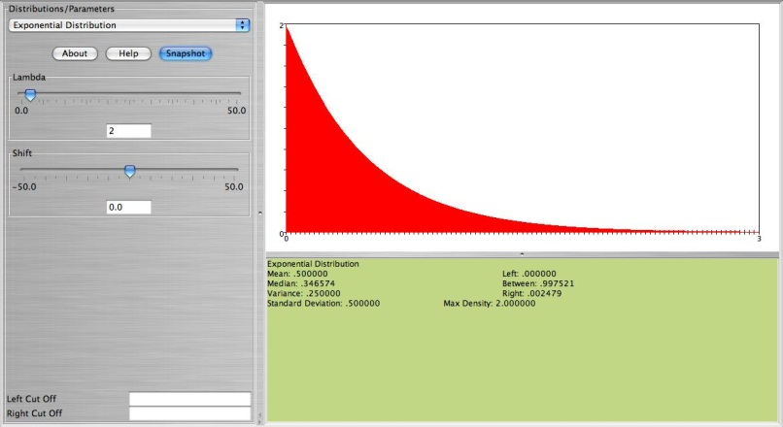
Distributions
FEATURES
70+ Distributions
Graphs
PDFs
CDFs
Inverse CDFs
Moments
www.socr.ucla.edu

Slide 6
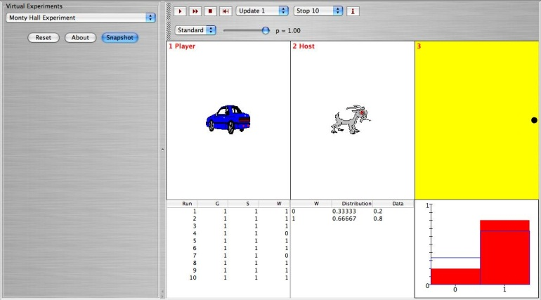
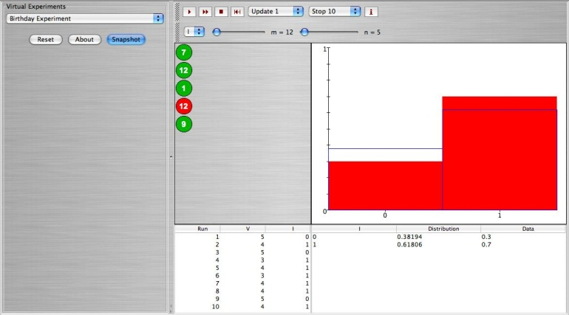
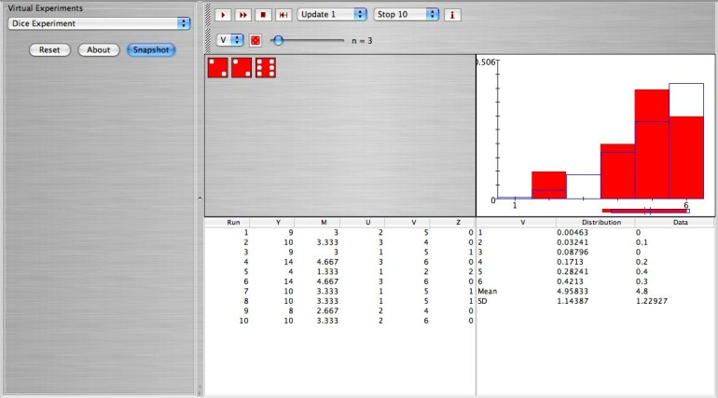
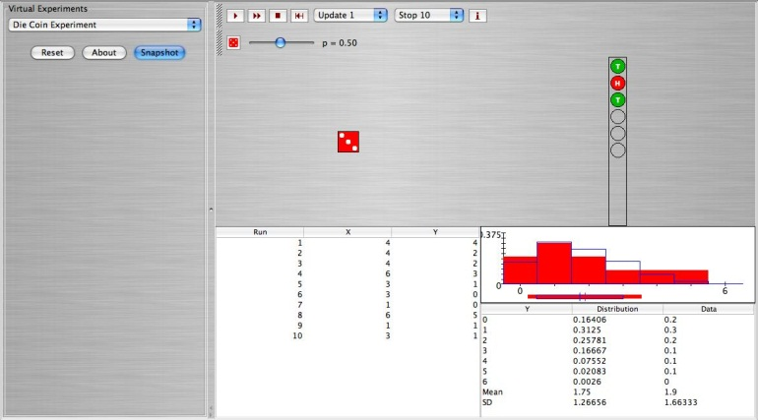
Experiments
FEATURES
80+ Experiments
Simulations
Summary Stats
Model vs. Sample
www.socr.ucla.edu

Slide 7
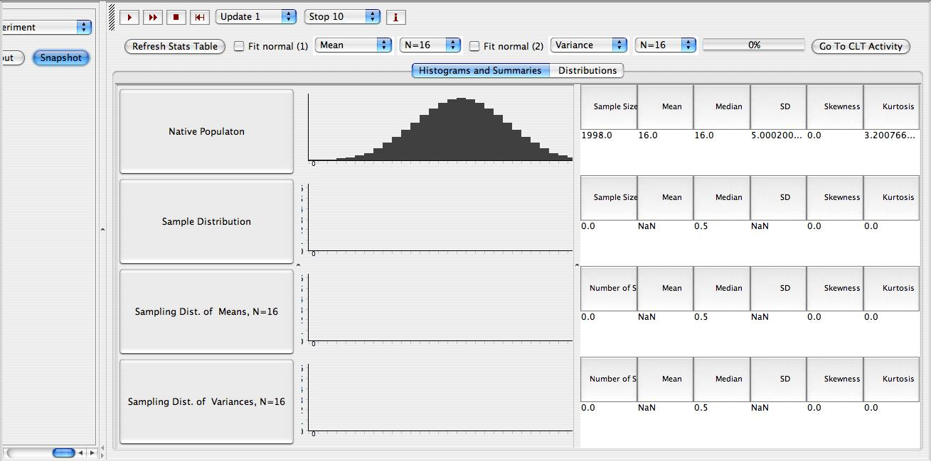
Experiments - CLT
www.socr.ucla.edu
Dinov, et al., JSE 2008

Slide 8
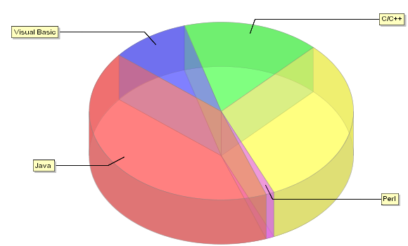
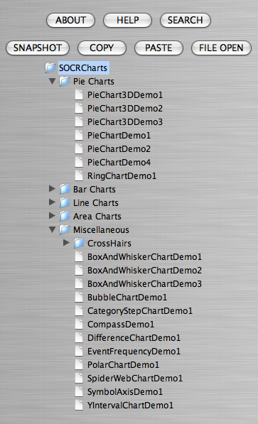
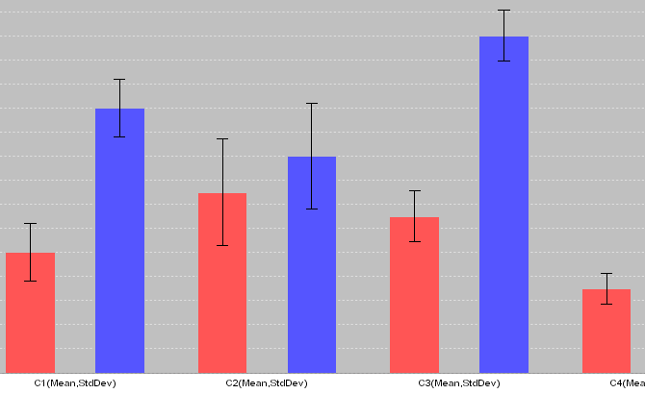
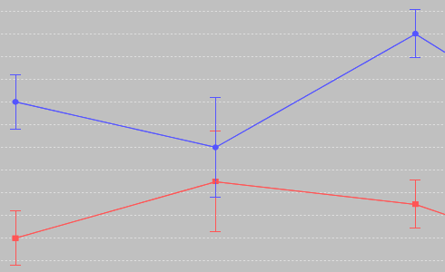
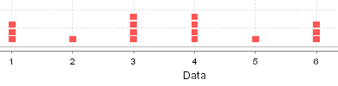
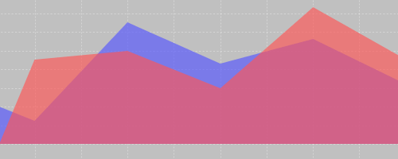
SOCR Charts
FEATURES
70+ Dynamic Interactive Graphs
Summary Stats
GUIs
Web Interface
Based on JFreeCharts
www.socr.ucla.edu

Slide 9
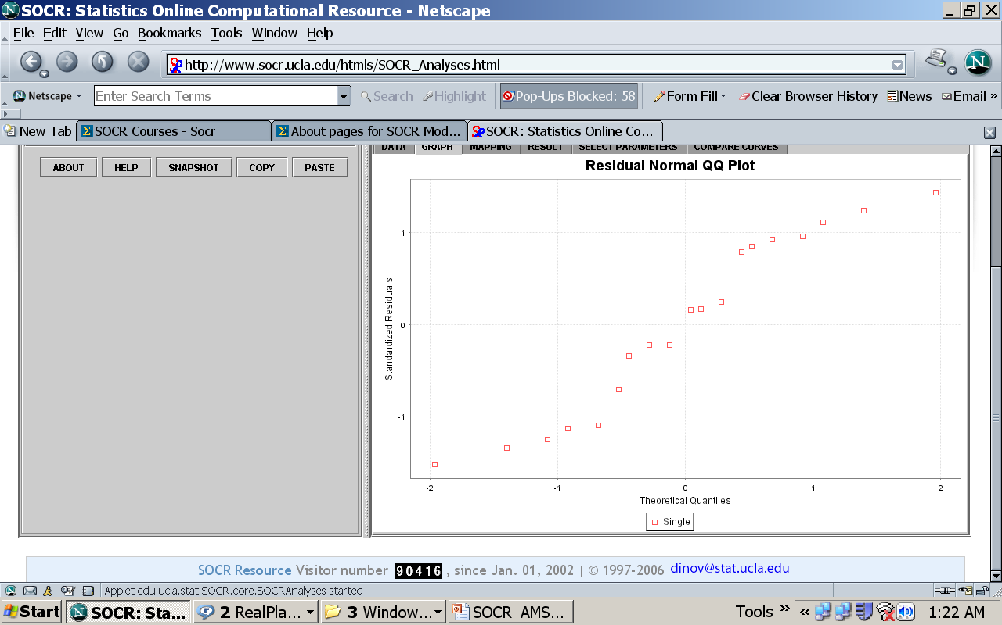
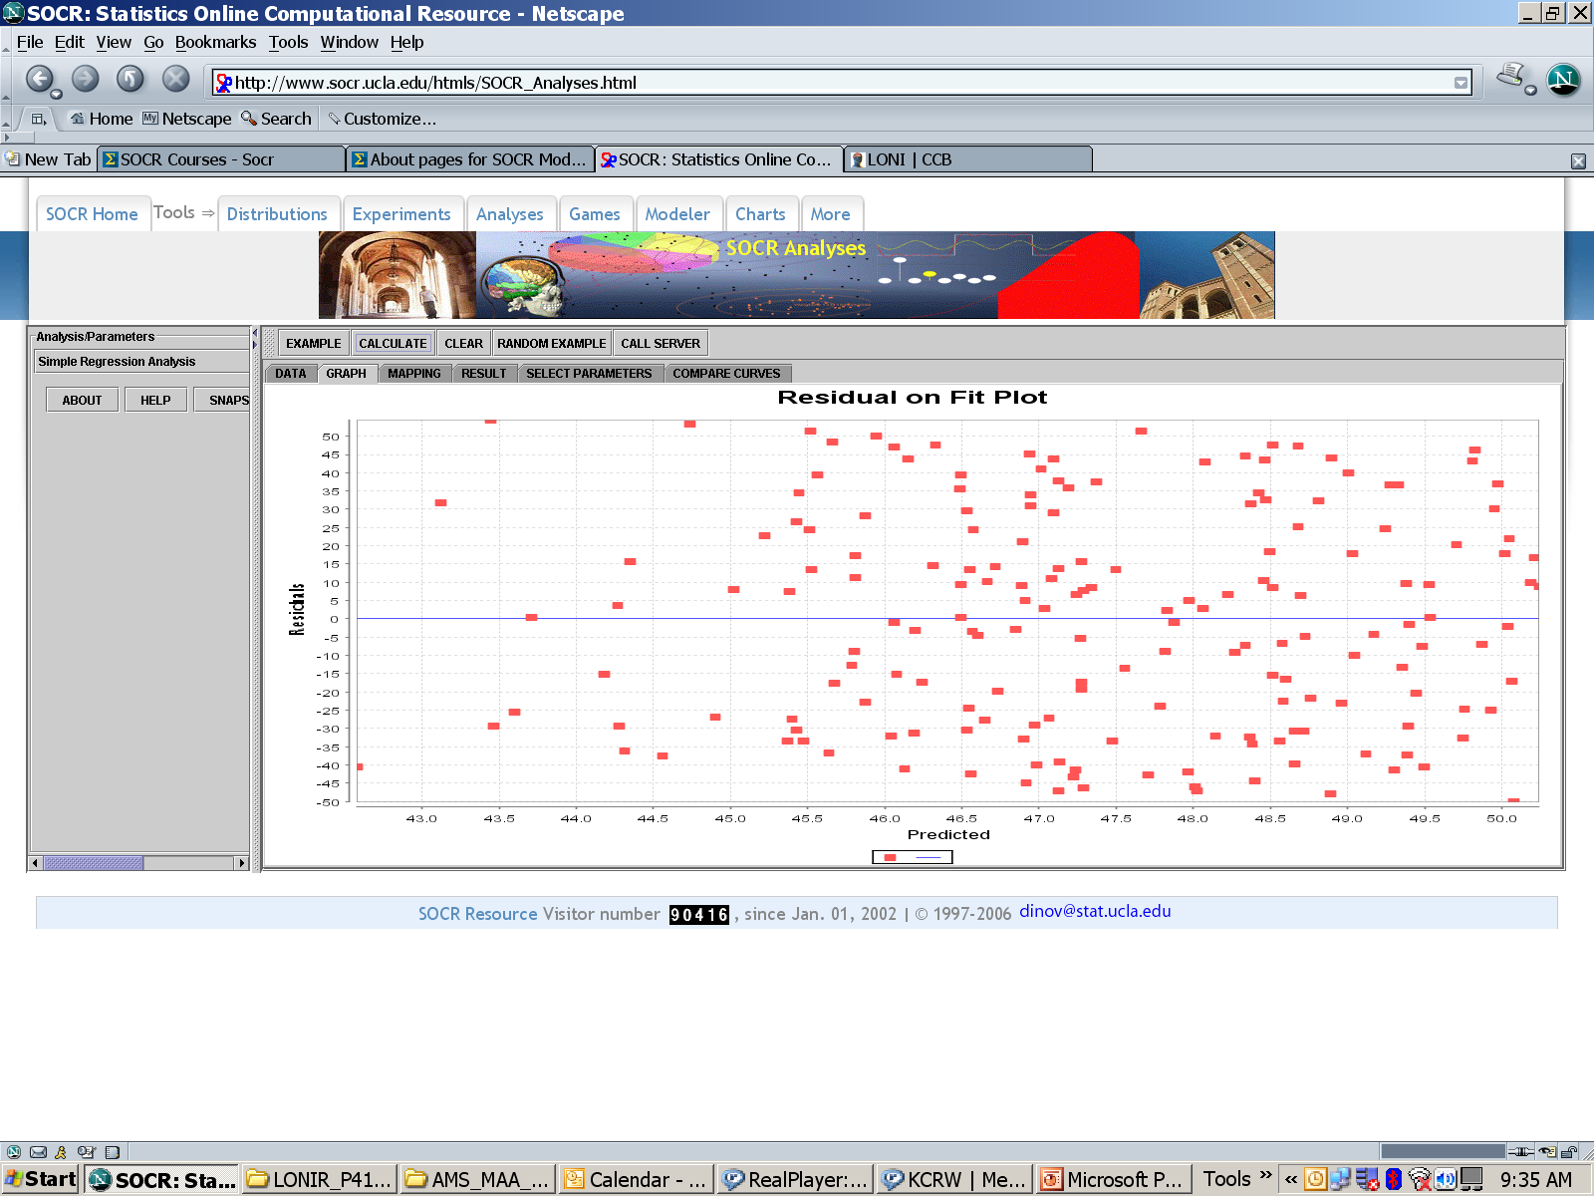

SOCR Analyses
RESULT:
Sample size=19
INDEPENDENT = Group
DEPENDENT = Dependent
DF Model = 2
DF Error = 16
DF Corrected Total = 18
RSS MODEL = 45030.94956140351
RSS ERROR = 2714.2083333333335
RSS TOTAL = 47745.15789473685
MSS MODEL = 22515.474780701756
MSS ERROR = 169.63802083333334
F-VALUE = 132.72658257916632
P-VALUE = 1.0907141856364433E-10
FEATURES
Param+NonParam
Graphs
Summary Stats
R Interface
GUIs
Web Interface
ANOVA - One Way
ANOVA - Two Way
χ² Model Goodness-of-Fit Test
Multiple Regression Analysis
One Sample T Test
Simple Regression Analysis
Two Independent Sample T Test
Two Independent Sample Wilcoxon Rank Sum Test
Two Paired Sample Sign-Test
Two Paired Sample Signed-Rank Test (Wilcoxon)
Two Paired Sample T Test
…
www.socr.ucla.edu

Slide 10
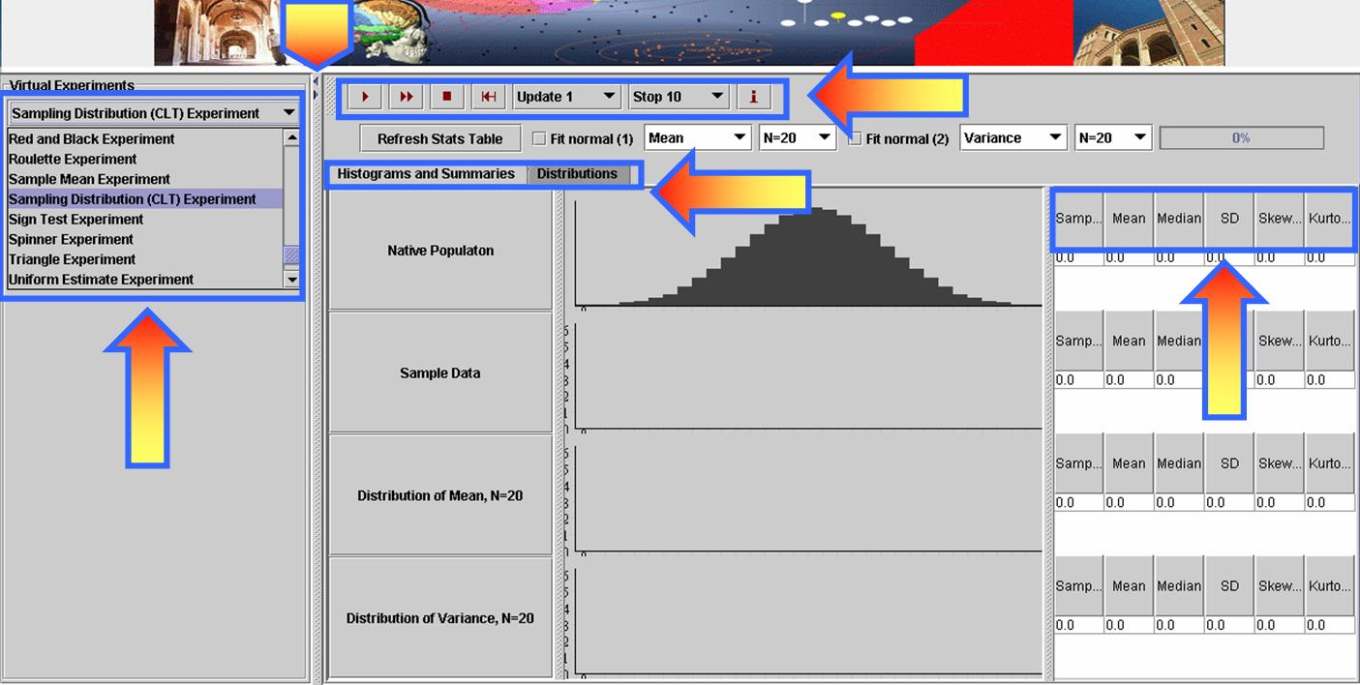
  Central Limit Theorem http://ucla.in/I1ZKq8

Slide 11
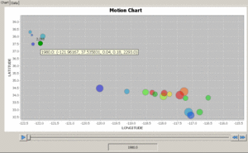
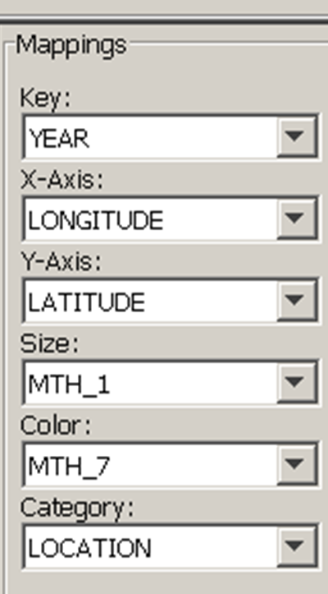
  California Ozone Data Activity http://wiki.stat.ucla.edu/socr/index.php/SOCR_MotionCharts_CAOzoneData

Slide 12
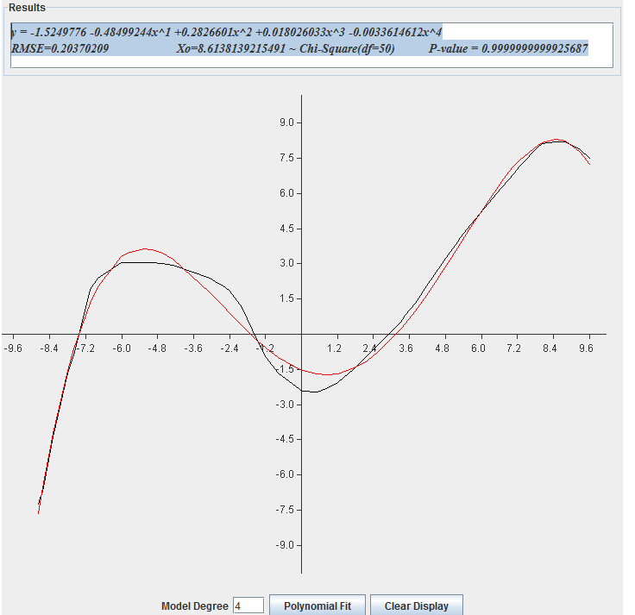
  Polynomial Model Fitting
  http://socr.ucla.edu/Applets.dir/SOCRCurveFitter.html

Slide 13
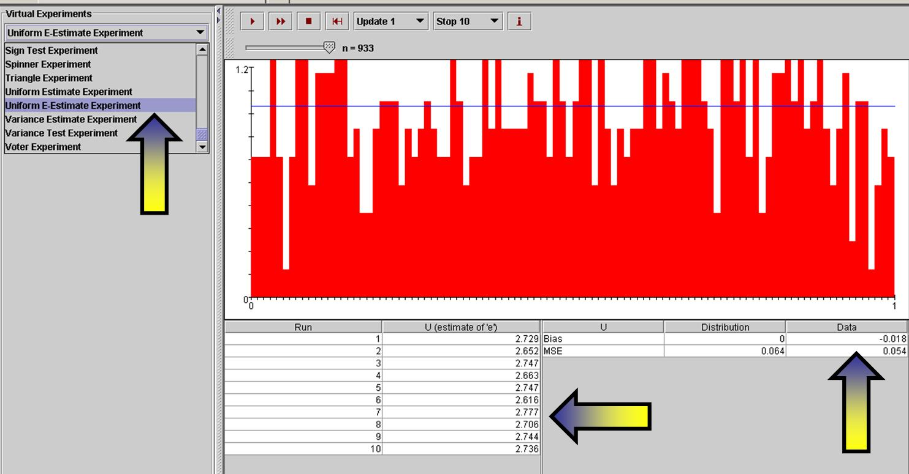
  Transcendental Number Estimation e and π
http://socr.ucla.edu/htmls/exp

Slide 14
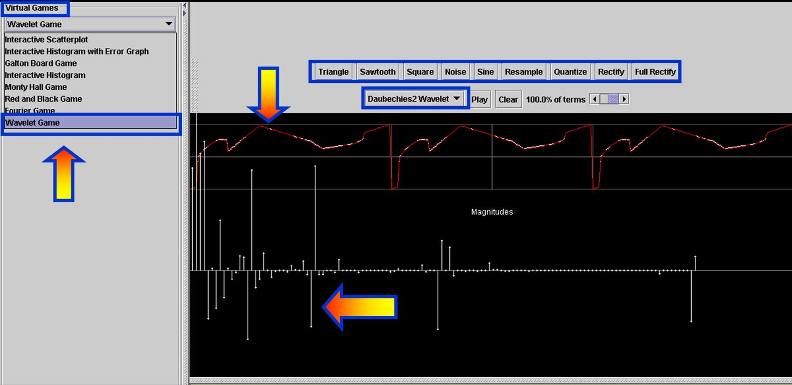
  Wavelet & Fourier Representation & Signal Denoising
http://socr.ucla.edu/htmls/game

Slide 15
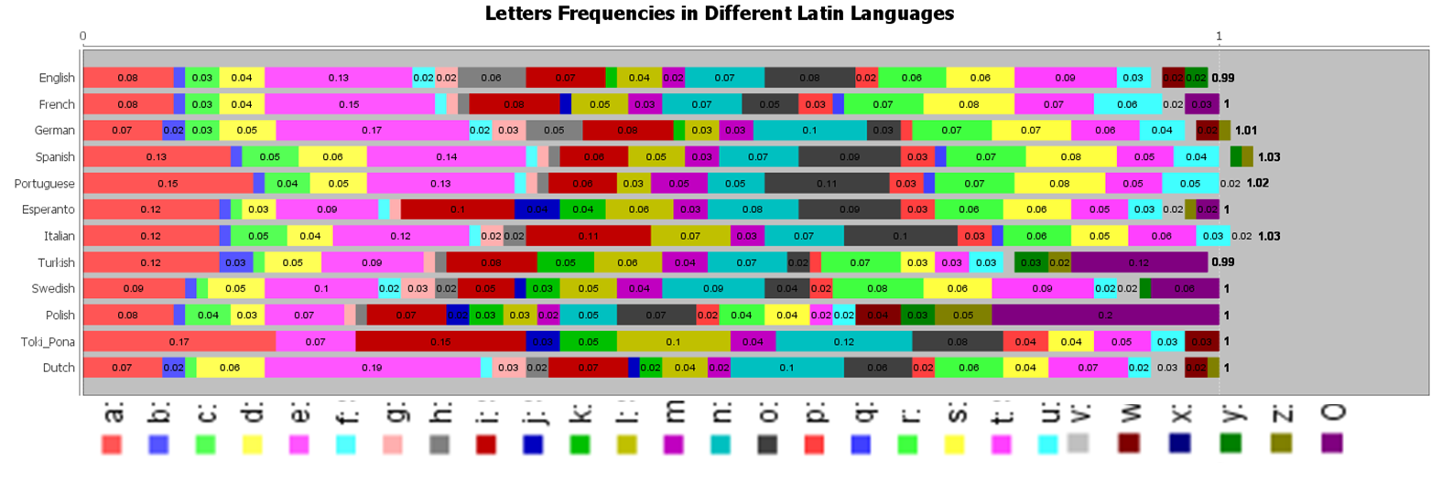
Data Example: Latin Letters Frequency Distribution
http://wiki.stat.ucla.edu/socr/index.php/SOCR_LetterFrequencyData

Slide 16
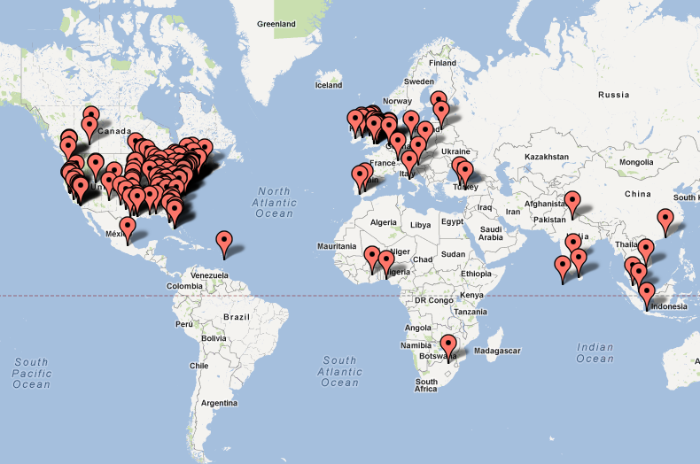
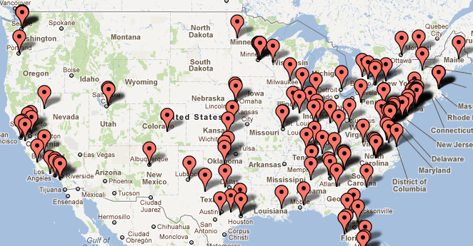
Future Research & Development
New tools under development
Additional SOCR Wiki activities
Annual SOCR Workshops
Evaluation
SOCR usage: www.SOCR.ucla.edu
Notes:
Users: Last 200 users (4-hour period ending 12:20 PM Pacific on 04/19/2012)

Slide 17
SOCR Curricular Assessment
http://socr.ucla.edu/htmls/SOCR_References.html
Conducted several IRB-approved studies of SOCR-blended instruction, compared to controls, quantifying the efficacy of the applets, materials and IT-enhanced curricular training in undergrad courses.
Christou, N and Dinov, ID (2010) A Study of Students’ Learning Styles, Discipline Attitudes and Knowledge Acquisition in Technology-Enhanced Probability and Statistics Education, JOLT, 6(3), 546-572
Dinov, ID, Sanchez, J, and Christou, N (2008) Pedagogical Utilization and Assessment of the Statistic Online Computational Resource in Introductory Probability and Statistics Courses, JC&E, 50, 284–300.
Christou, N, Sanchez, J and Dinov, I. (2007) Design and Evaluation of SOCR Tools for Simulation in Undergraduate Probability and Statistics Courses. Proceedings ISI, Lisbon, Portugal, August 2007.
Notes:
We have conducted several control-based studies of the efficacy of technology-enhanced statistics education. Using IRB-approved studies, quantitative and qualitative measures of student performance were recorded in classes using traditional (control) instruction (R or Stata based) and classes using SOCR resources and tools. Non-parametric analyses of the data showed very statistically significant (SOCR) treatment effects (p < 10 ⁻ ⁴) on student performance and perception of the material. The practical significance of these treatment effects were more modulated. More details about these studies are available here.

Slide 18
Session Evaluation/Feedback
Provide Anonymous Feedback Online
http://socr.ucla.edu/htmls/SOCR_Feedback.html
Notes:
Users: Last 200 users (4-hour period ending 12:20 PM Pacific on 04/19/2012)

Slide 19




Acknowledgments
Funded by
NSF DUE 0716055
Collaborators
I. D. Dinov, N. Christou, R. Gould
J. Cui, A. Che, R. Gidwani
http://www.socr.ucla.edu/htmls/SOCR_Acknowledgements.html
http://www.socr.ucla.edu/htmls/SOCR_References.html
www.SOCR.ucla.edu
www.StatisticsResource.org

